Slide 3
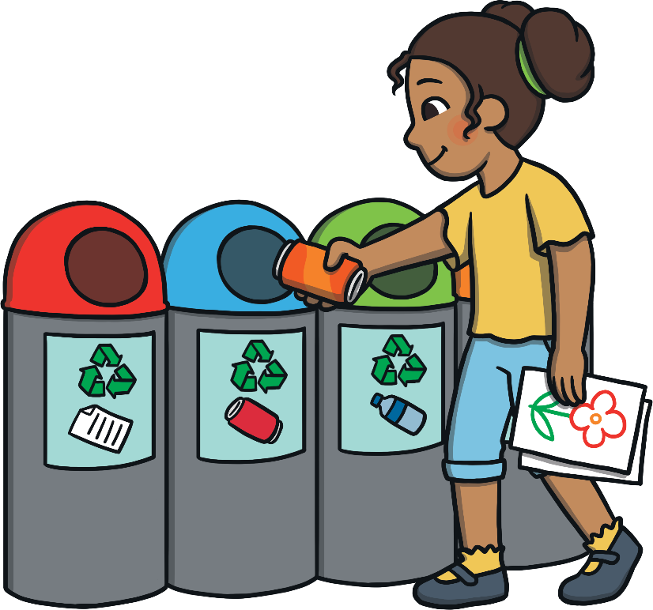
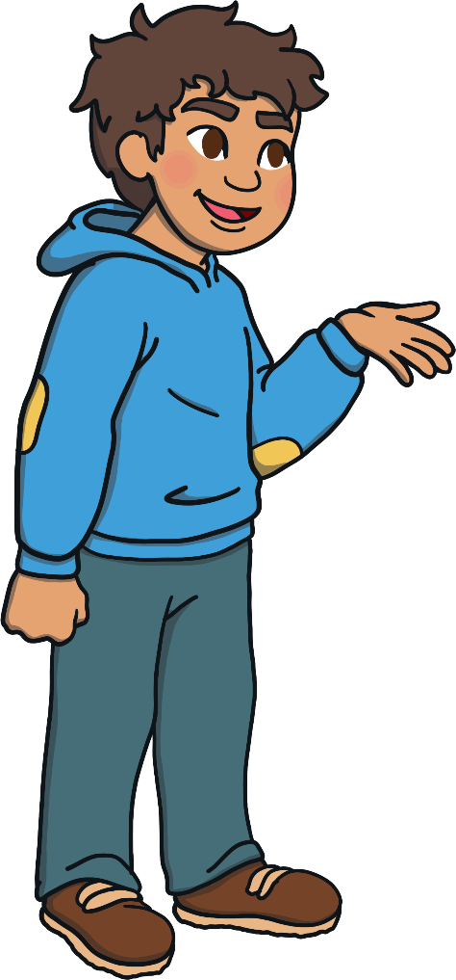
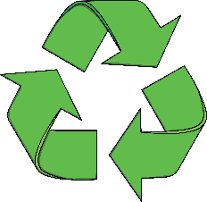
Remarkable
Recycling
Do you know what recycling is?
Do you recycle at home or school?
What things do you recycle?
Have you ever seen this symbol before?
Do you know what it means?

Slide 4
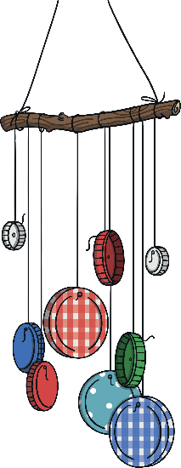
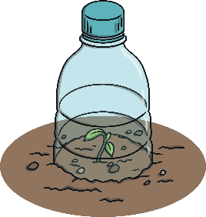
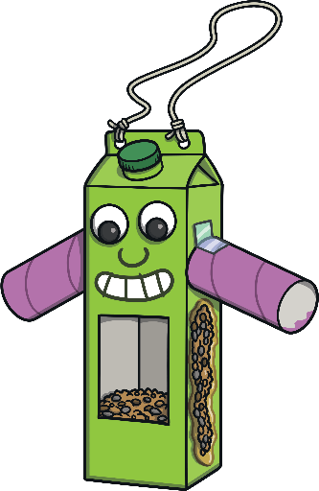
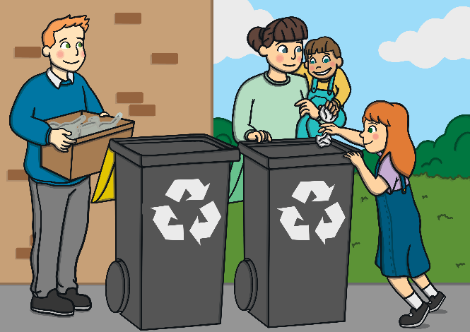
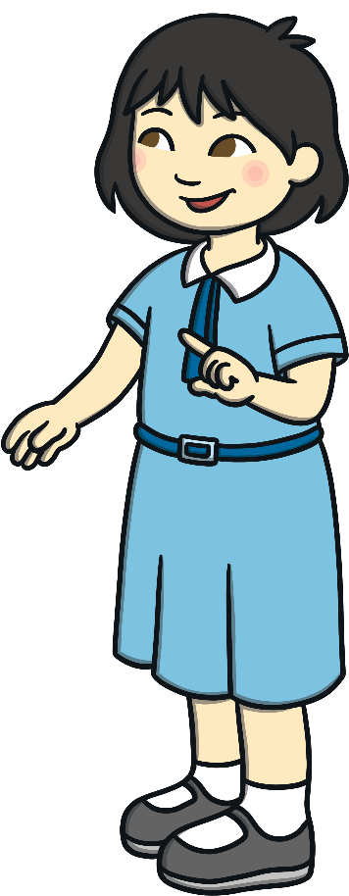
What is
Recycling?
Recycling is when rubbish is turned into something new.
You might be able to recycle some things yourself, by reusing them or making something out of them.
Other things are taken away to be recycled.
Did you know that around half of your rubbish can be recycled?

Slide 5
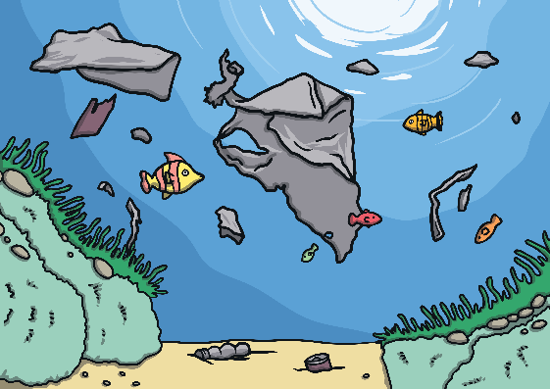
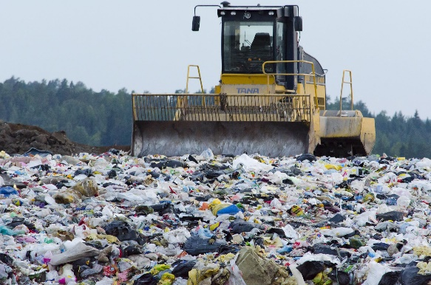
Why is Recycling
Good?
Rubbish that isn’t recycled can end up going into landfill. More and more rubbish gets piled up and then some of it can make its way into animal homes, such as seas, rivers and woodlands, which can be very harmful to wildlife and humans.
It also uses lots of energy and natural resources, such as trees, to make brand new paper, cardboard and plastic objects. We can save energy and help to look after the environment by recycling.

Slide 6
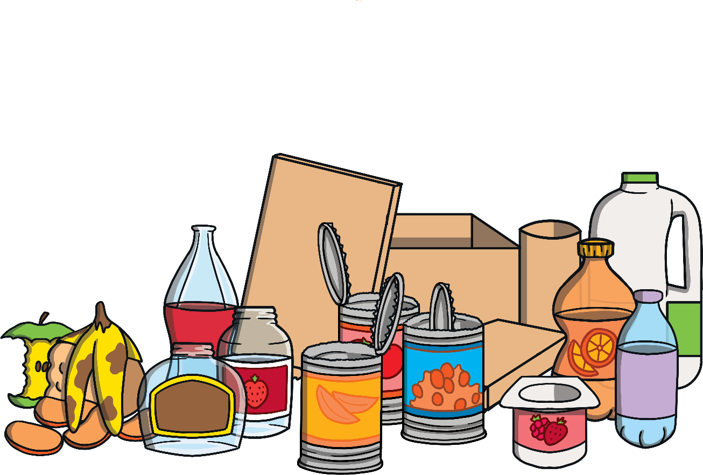
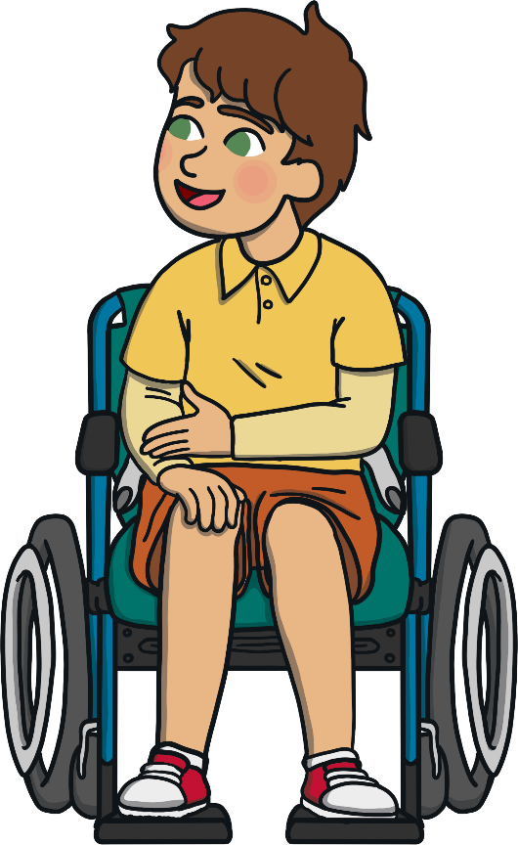
What Can Be
Recycled?
Most paper and cardboard can be recycled.
Lots of types of plastic can be recycled.
Most glass can be recycled.
Most metals can be recycled.
Did you know that even old food can be recycled? It can be turned into fertiliser for farmers to use, or it can even give off a special gas that can be used to make electricity!

Slide 7
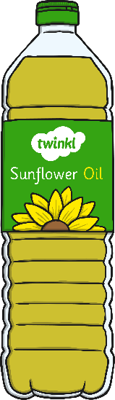
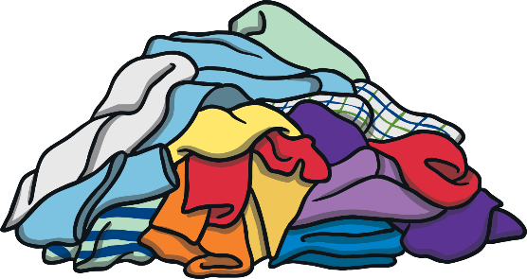
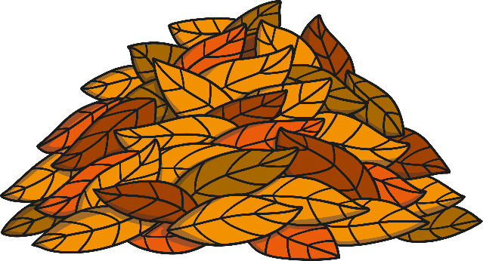
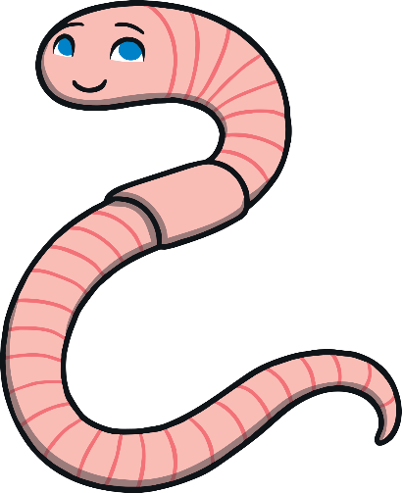

Can Any Other Things
Be Recycled?
  Used cooking oil can be turned into something called biodiesel, which can be used to fuel lorries.
Clothes can be recycled by donating them to charities so that other people can wear them. They could also be used to stuff furniture.
I can help with that!
  Things like crisp packets and food pouches are a bit more tricky to recycle, but some special companies can do it.
Garden rubbish like leaves or grass cuttings can be turned into compost.

Slide 8
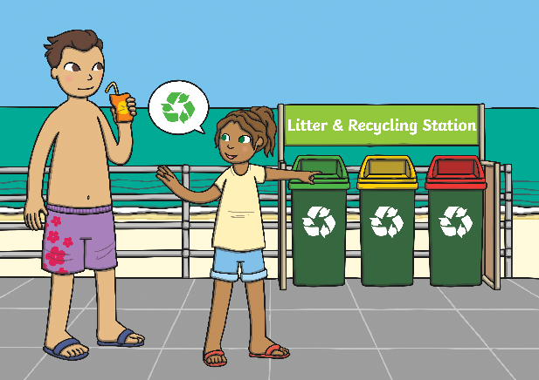
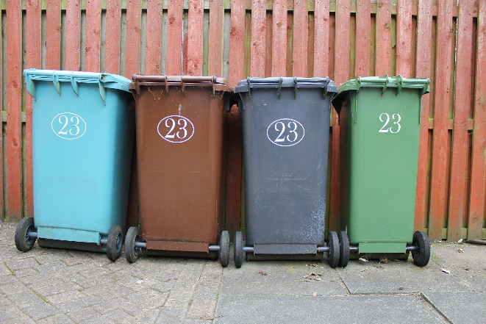
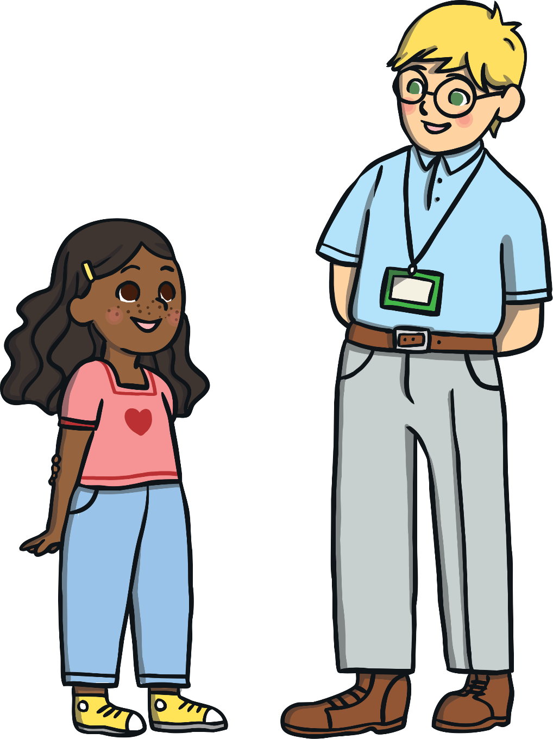
Where Do We Put
Our Recycling?
Look out for recycling stations when you’re out and about in your local area!
We can put our recycling into the recycling bin at home or school. In certain places you may need to separate the cardboard and paper, metal, glass and plastics, but sometimes they can all go in one big bin or bag.
Have you ever wondered what happens to your recycling after you’ve put it in the recycling bin? Let’s find out!

Slide 9
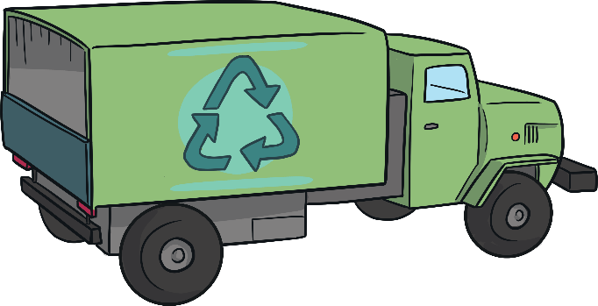
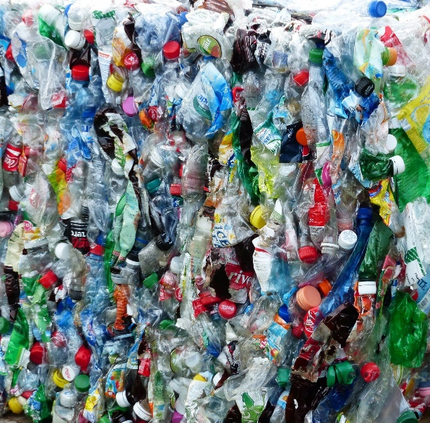
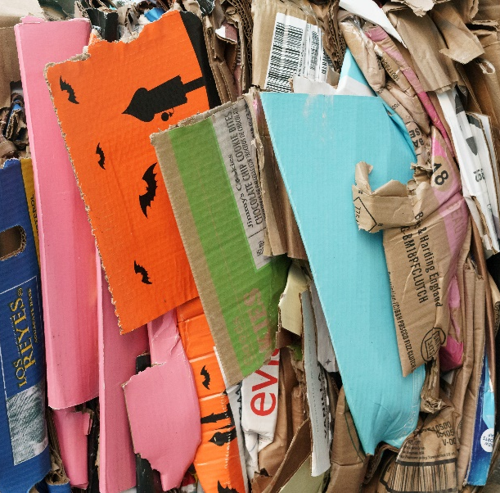
Where Does the Recycling Go Next?
A recycling lorry comes to collect the rubbish from outside your home and then takes it to a place called a recycling facility.
At the recycling facility, the rubbish is sorted and put into big bundles before being taken to factories to be turned into something new.

Slide 10
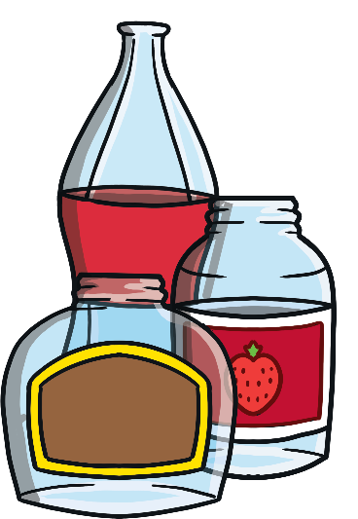
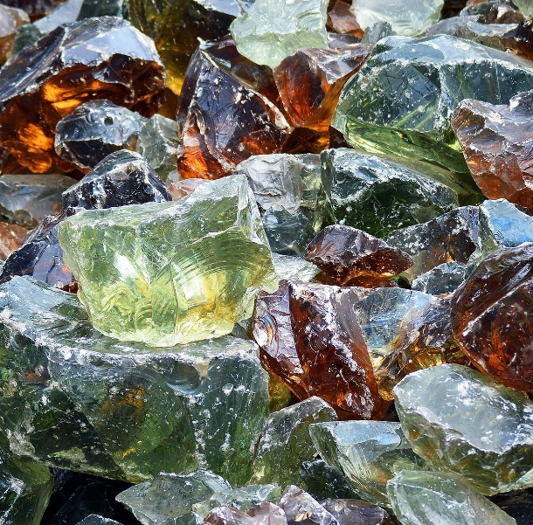
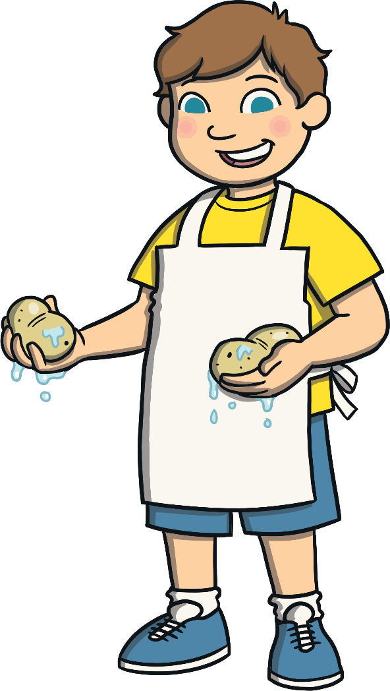
How Are Materials Recycled?
Clever machines sort glass into different colours.
It is then crushed into tiny balls before being
heated up and melted into liquid glass.
The liquid glass can then be moulded into the shape of new bottles or jars before it cools down and becomes hard again.
It’s a bit like when you melt chocolate to make crispy cakes!

Slide 11
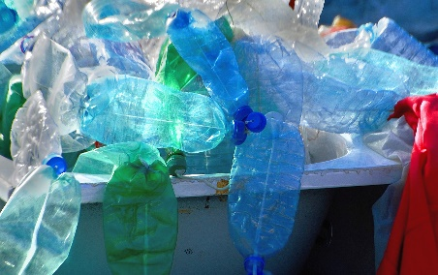
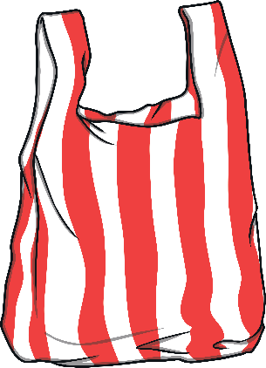
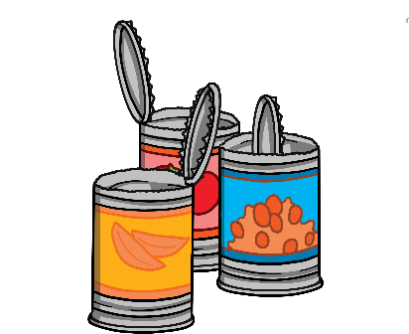
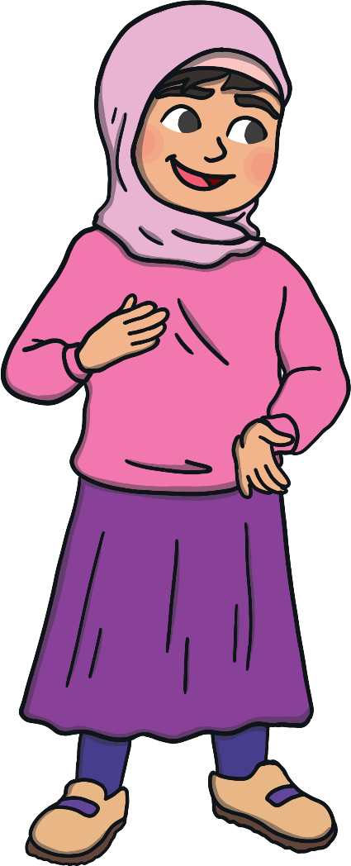
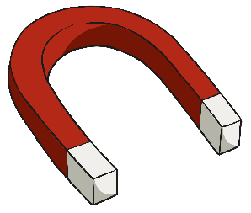
How Are Materials Recycled?
Plastics and metals are shredded into little strips before also being melted and made into new things.
Plastics can be turned into new carrier bags, bottles and even T-shirts!
Metals can be made into drinks cans and even new metal parts for cars.
Did you know that huge magnets pick up all the metal things from the pile of rubbish?

Slide 12
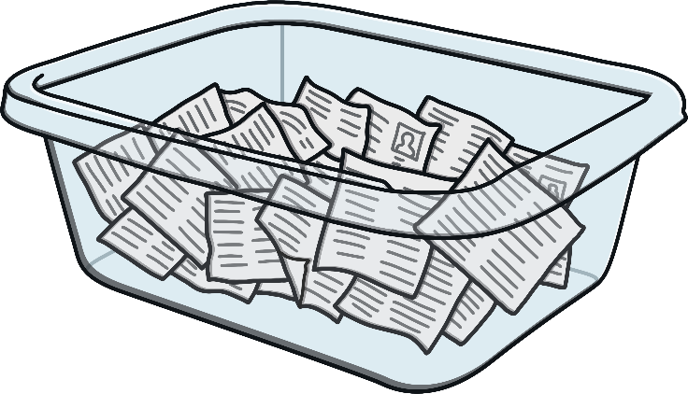
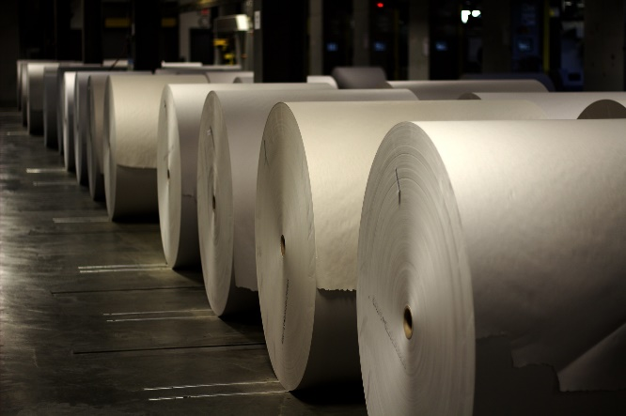
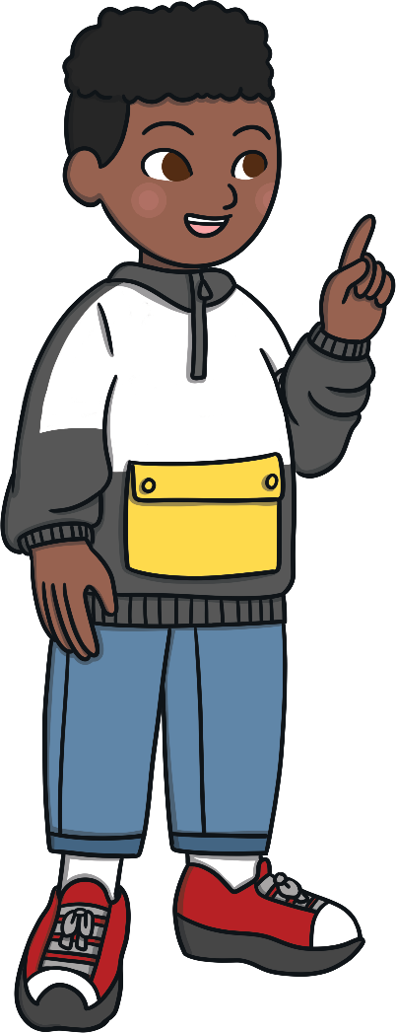
How Are Materials Recycled?
Paper is washed in soapy water. It is then
mixed and rolled out before being left to dry. It is then turned into different types of new paper and card, such as newspapers.
You can make your own recycled paper at home in the same way!

Slide 13

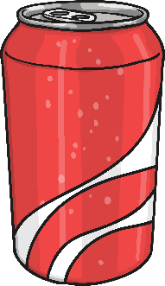
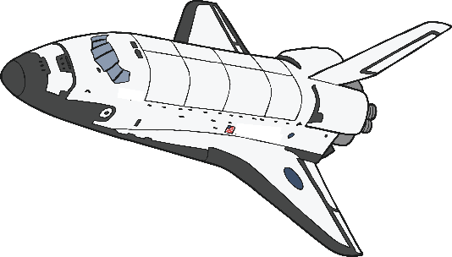
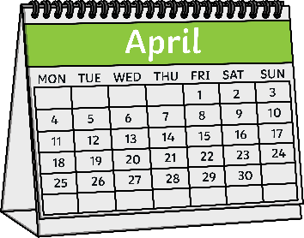
Fun Recycling
Facts
Recycling one plastic
water bottle saves enough energy to power a lightbulb for around 3 hours.
If you recycle a drinks can,
it only takes around 60
days for it to be recycled
and made into a new can.
It’s always important to recycle, but during the year there are special times that we can think especially hard about what we can do to help the planet, such as Recycle Week, Earth Day and World Environment Day.
Each year in the UK, by recycling glass, we save enough energy to launch about 10
space shuttle missions!

Slide 14
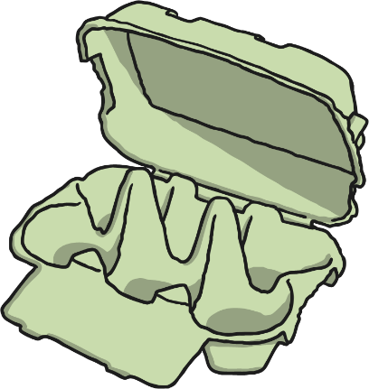

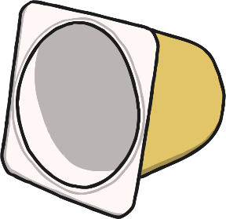
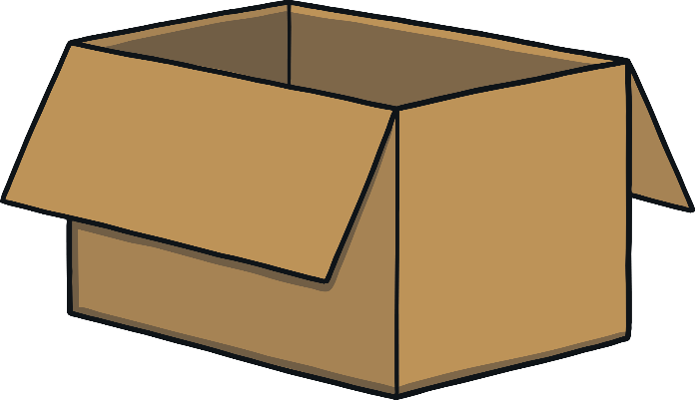

What Do We Know
About Recycling?
What have you learnt about recycling?
Can you think of any things at home or school that you could recycle?
You can help to look after me by recycling more!

